Slide 1

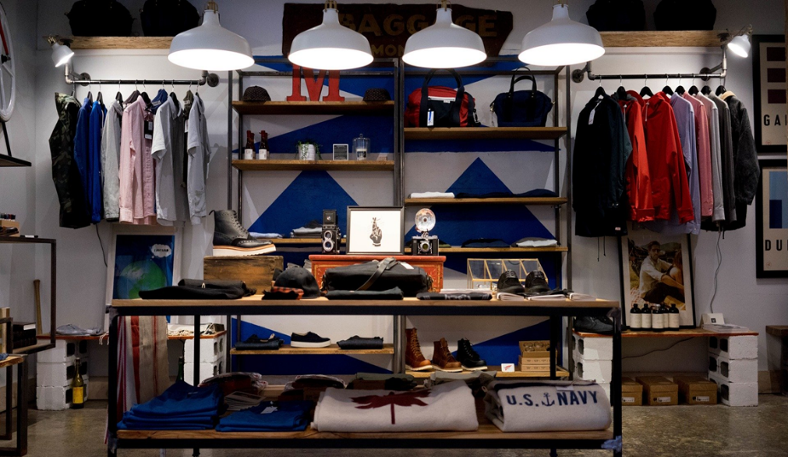

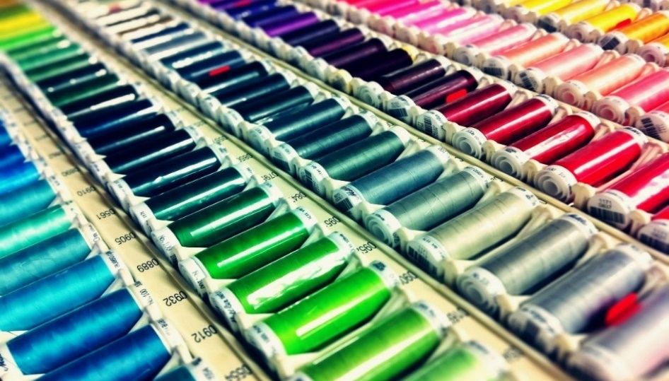
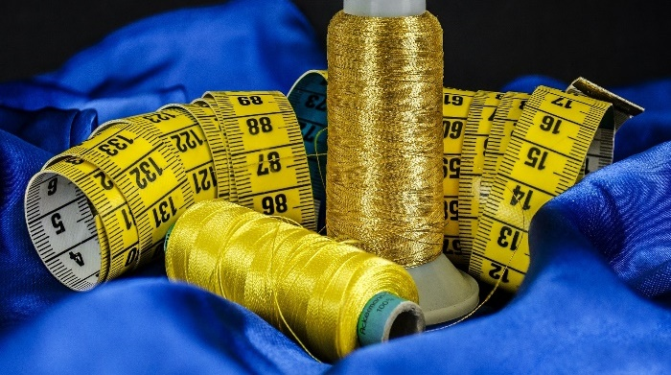
DISPOSABLE FACE MASKS
(Non-Sterile)
EPIC Group
27thMay 2020
This presentation is strictly for the people who receive it from the authorized executive of EPIC Group. This may contain copyright material and therefore strictly prohibited for any further circulation.
Notes:
Page 1

Slide 2
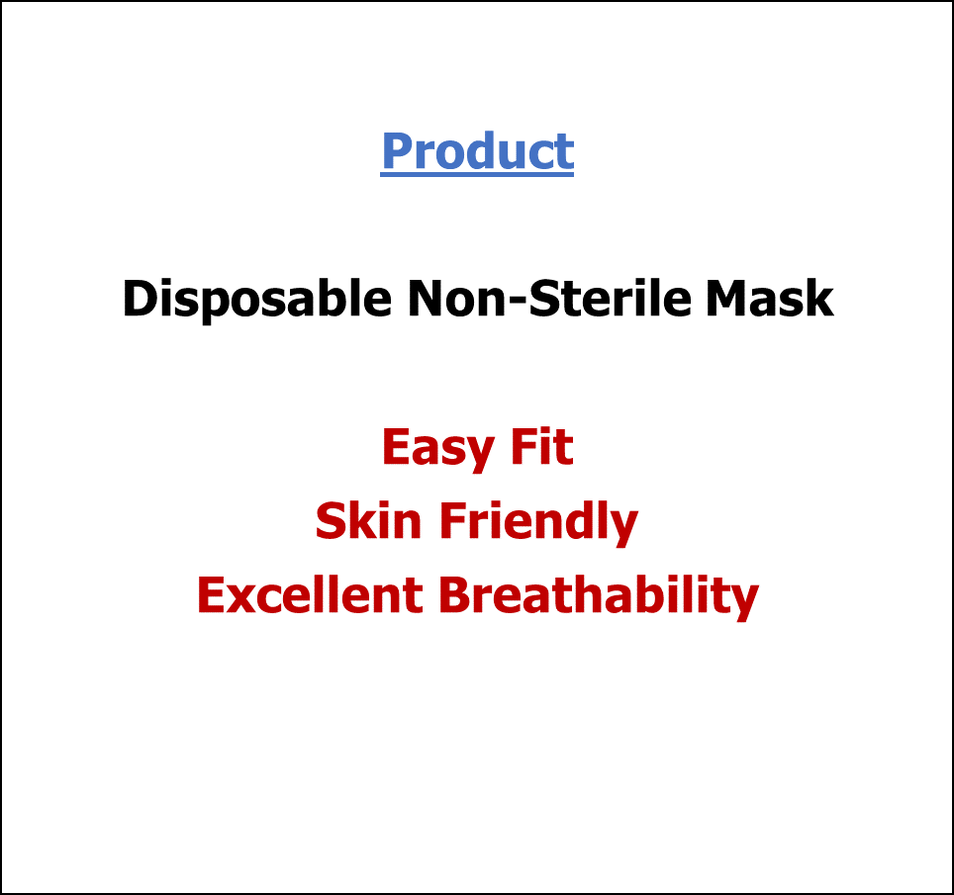

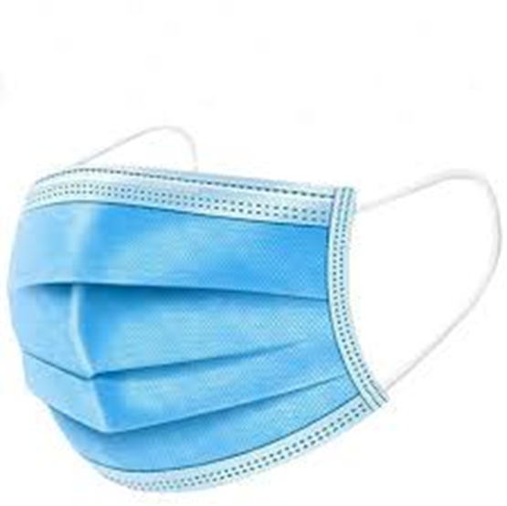
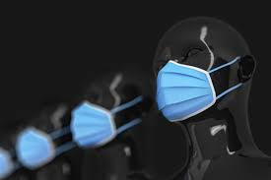
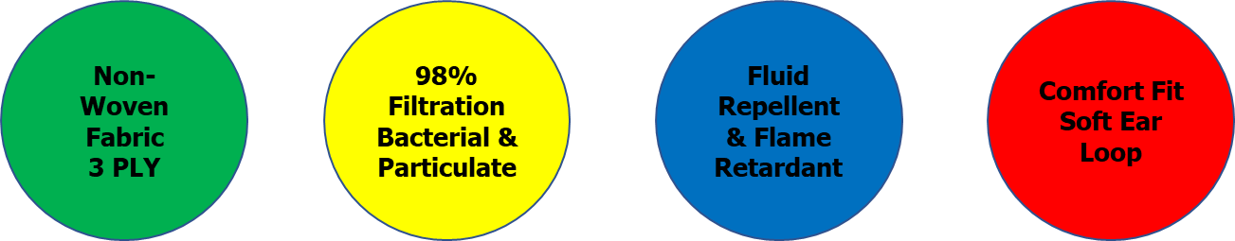
EPIC Apparel PLC
Hawassa Industrial Park
As a responsible Business House , We are Concerned for the People’s Safety & Health
Our Initiative – “Made in Ethiopia” World Class, Quality Disposable Masks

Slide 3
Technology
Fully Automated Machine using World Class Technology,
No Human intervention in handling the product Superior hygiene & no contamination
The Manufacturing Process is in a Temperature, Humidity and Particulate matter controlled environment in a Class 100000 Clean Room ,.
Strict Hygiene standards maintained for the employees involved in the manufacturing,
Quality
At EPIC we follow a two-factor quality control for our Product
Raw material – From US FDA & CE Certified Source,
  Raw materials inspection at source
  Raw materials testing for all required parameters at origin before dispatch
Product
  Visual inspection during production process
  Audit of packed goods using random sampling
  All physical and testing parameters certified by 3rd party WHO recognized laboratory,
  Lab Recommended / Approved by the Customer,

Slide 4
Tests and Certification
BFE% ≥98%,
PFE% ≥98%,
Product EFDA
Certified
Raw Materials
US FDA & CE Certified Source
ASTM F2100-2019 – L1, L2
OR
EN 14683 -2019 –Type I, II, IIR
Splash Resistance 120mmHg
Flammability –Class 1
Differential Pressure < 5mm H₂O / cm²
BREATH EASY ~ STAY SAFE

Slide 5
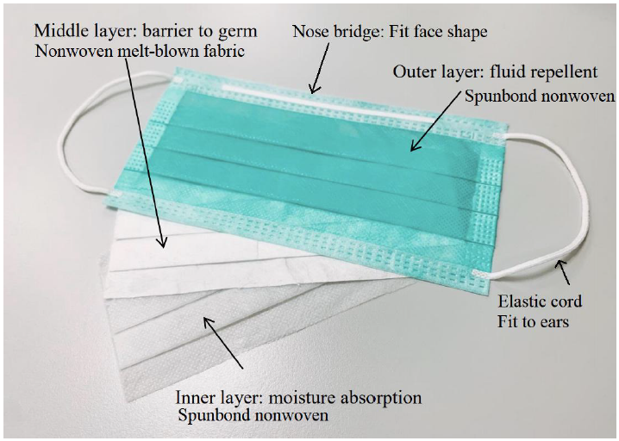





Product Performance ,Tests and Certification
Mask Component | Outer Layer | Middle Layer | Inner Layer | Nose Bridge | Ear Loop
*Reference Picture
*Industrial Name | 100% PP Spunbonded Nonwoven | 100% PP Melt-Blown Nonwoven | 100% PP Spunbonded Nonwoven | Nose Bridge -Plastic Covered Aluminum Wire | Soft Ear Loop Strap
*Performance | Fluid Repellent | Barrier to germs -BFE ≥ 98% | Moisture Absorption | Fit to Face Shape | Fit to Ears
*Dimensions | 175mm x 95mm | 175mm x 95mm | 175mm x 95mm | 90mmx2.5mm | 180 mm (3mm Diameter)
*Approx. Weight | 20 gsm | 25-30 gsm | 25-30 gsm
Notes:
Page 3

Slide 6
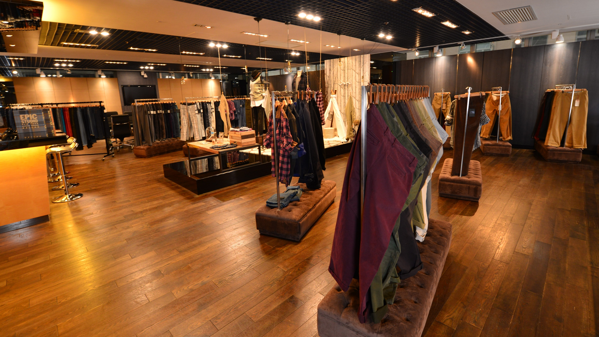

Thank You
Epic Group
The information contained herein is of a general nature and is not intended to address the circumstances of any particular individual or entity. Although we endeavor to provide accurate and timely information, there can be no guarantee that such information is accurate as of the date it is received or that it will continue to be accurate in the future. No one should act on such information without appropriate professional advice after a thorough examination of the particular situation.
© Epic Group is a Hong Kong registered company, affiliated with ____
The EPIC Group name and logo are registered trademarks. All rights reserved.
Mr Shivakumar Simha
+251 980397544

